Slide 1



Tips on image databases, screen clipping and image editing
Created as a learning unit on digital tools by Jana Eckert for the 3rd Bridge the Gap! workshop in Bad Vilbel on 20 September 2022.

Slide 2
What is this unit about?
Where can I find pictures and graphics that I can use for public relations?
Tip for creating screenshots
Tip for editing graphics

Slide 3
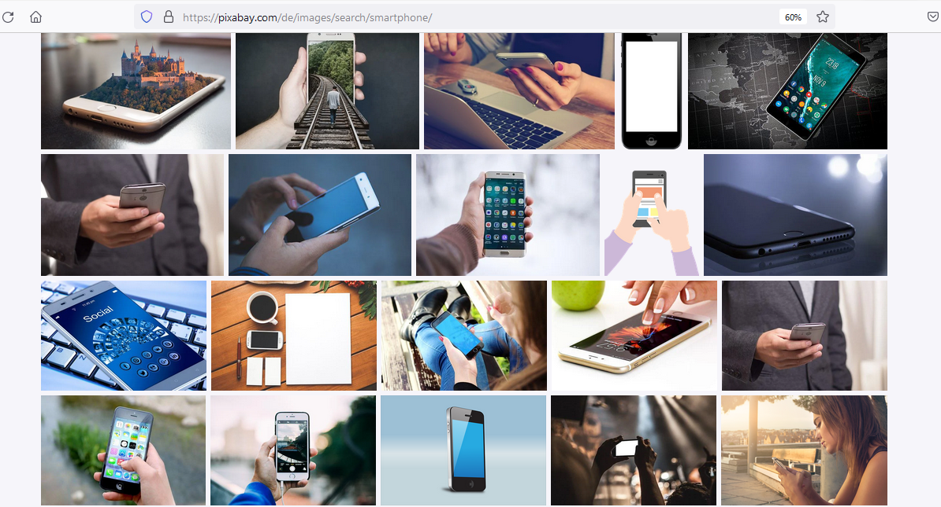
Image databases
Notes:
Here you can find free images and graphics without registration. Pixabay also suggests images from iStock.

Slide 4
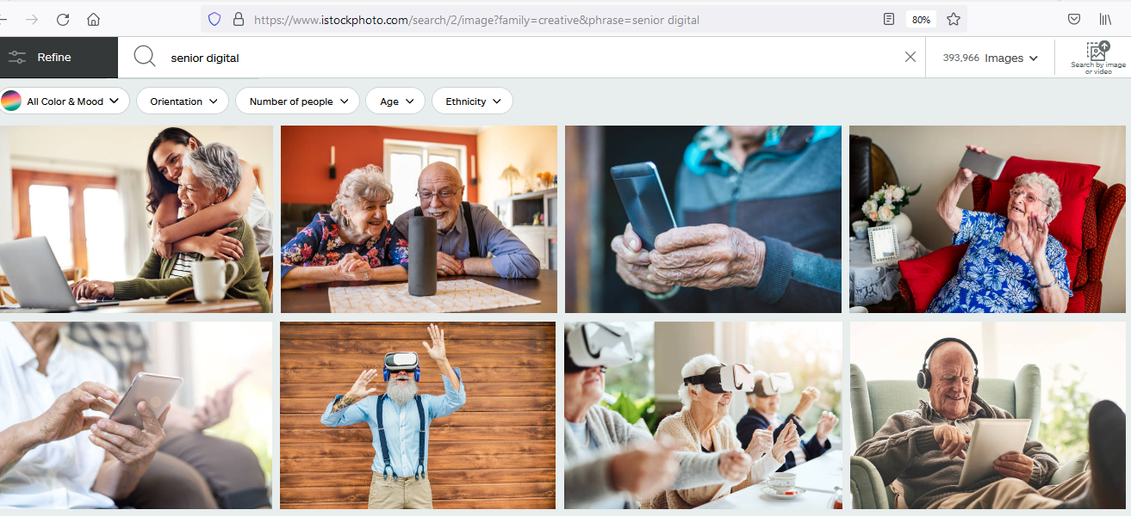
Image databases
Notes:
At iStock there is a very large range of images in different price ranges (9€ or 24€ per image). However, purchasing a licence for an image can be worthwhile if you want to create very attractive material.

Slide 5
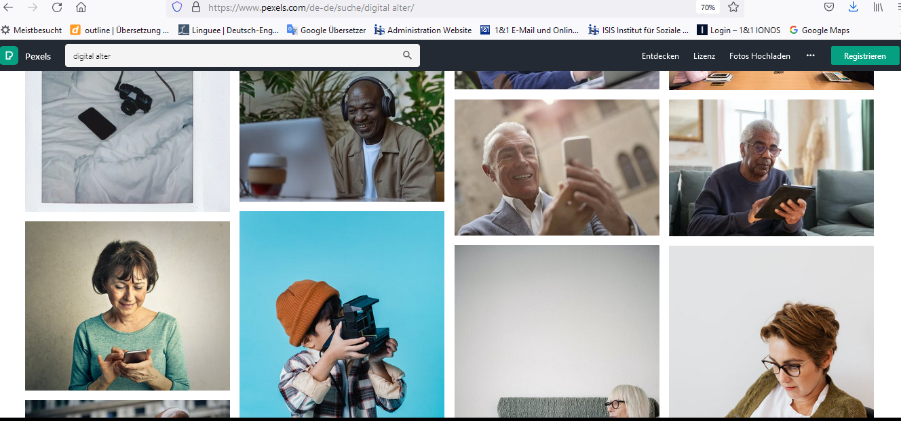
Image databases
Notes:
The images can be downloaded free of charge and used, changed and edited without restriction. Registration is not necessary, but is recommended for high-resolution images.

Slide 6
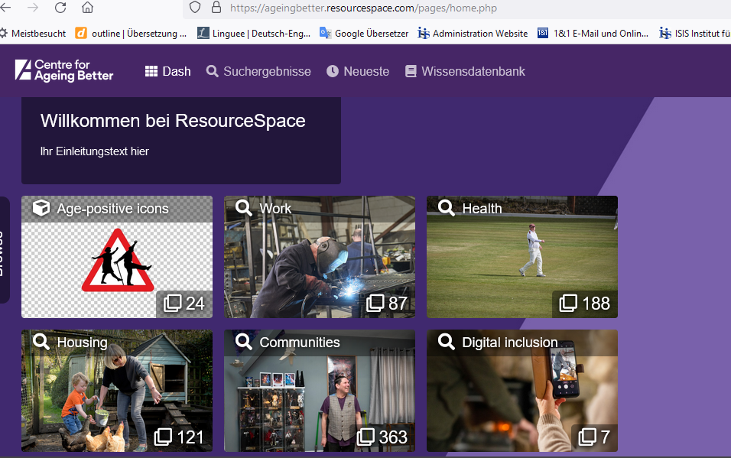
Image databases
Notes:
Image databases with positive images of old age:
The Centre for Ageing Better (non-profit organisation in England and Wales) has created a small database of images that portray people over 50 in a positive and realistic way.
The pictures are free of charge, registration is not necessary, but the specification of the e-mail address is required. The number of images is quite small.

Slide 7
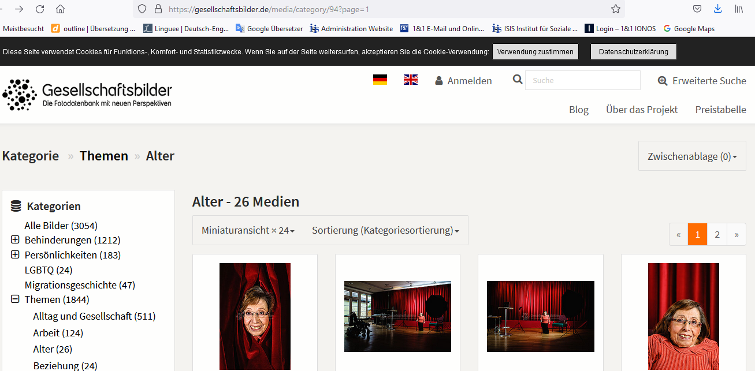
Image databases
Notes:
The database is run by the association "Sozialhelden". It offers "stereotype-free images" , especially of people with disabilities.
"The photo database is intended to be an offering to reflect the diversity of society." (https://gesellschaftsbilder.de/page/%C3%9Cber%20das%20projekt)
The editorial use of the images is free of charge, but indicating credit is required.

Slide 8
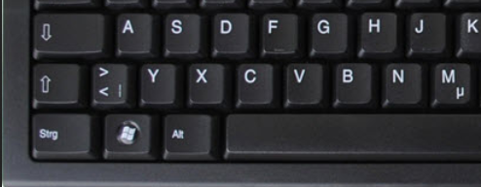
Often useful: Photograph screen contents with „Snip and sketch" (Windows 10)
If you want to take a sceenshot of a part of the screen without much effort, use “Snip and sketch" by pressing the key combination "Windows key + Shift key + S".
Notes:
The „Snip and Sketch" app replaces the previous snipping tool for "cutting out" an area on the screen.
You can create screenshots in Windows 10 with the „Snip and Sketch" app. Since the "Windows 10 October 2018 Update", the new screenshot programme is already pre-installed.

Slide 9
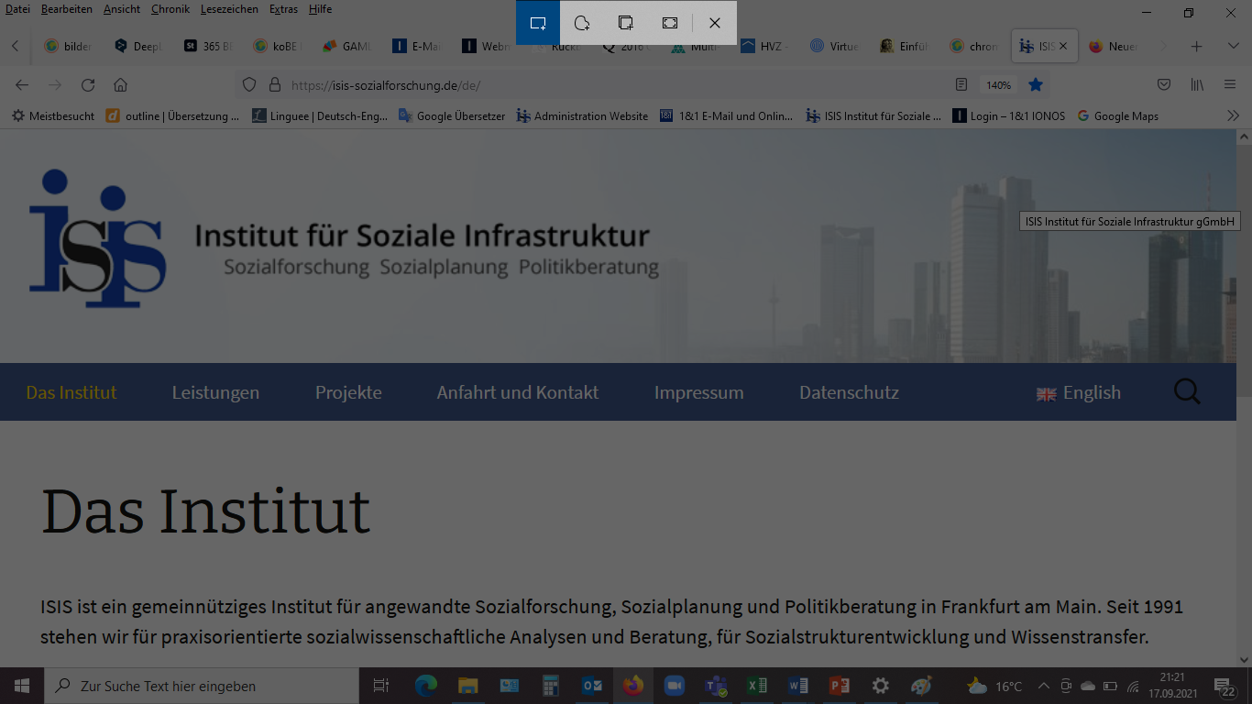
Exercise for the learning unit
Rectangular snipping
Snip full screen
Free snipping
Snip window
Notes:
One possibility is: rectangular snipping (to do this, draw a rectangle with the mouse around the area you want to save as a screenshot). Other ways to take a screenshot are: free snipping, snip window, snip full screen or close.

Slide 10
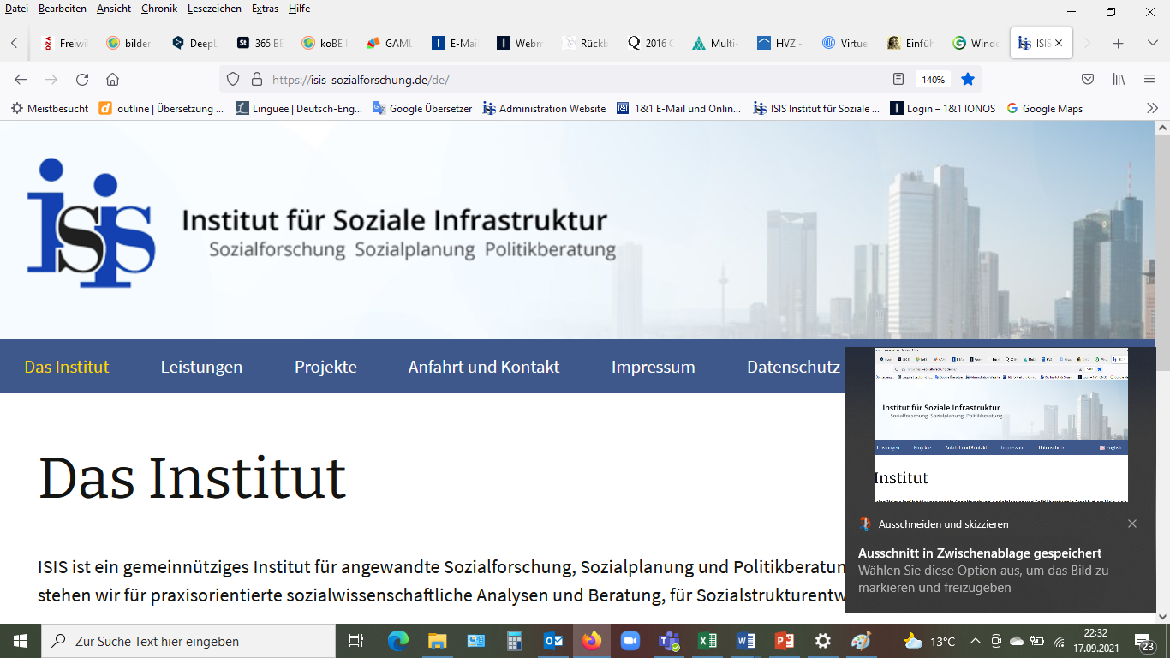
Notes:
The section is now on the clipboard and can either be pasted into PowerPoint, Word, paint etc. or click on the text below.

Slide 11
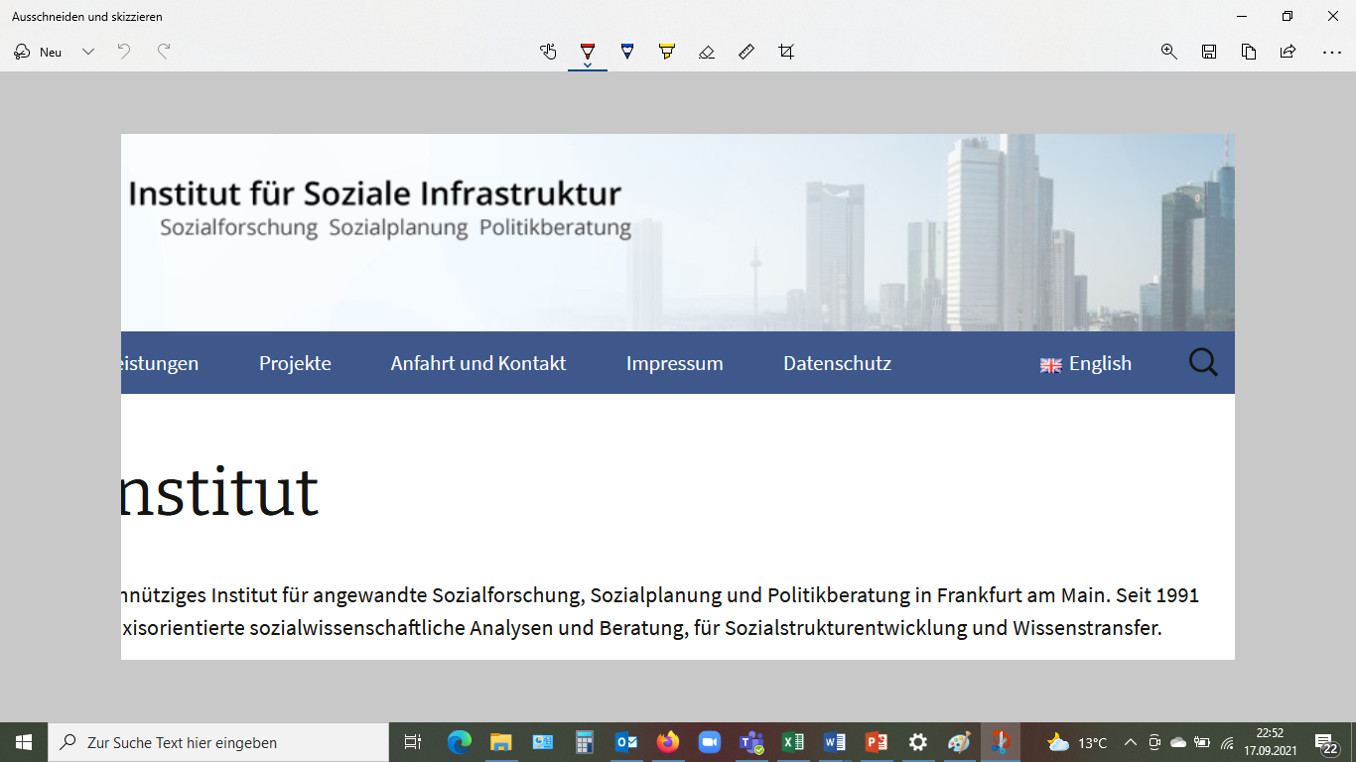
Exercise for the learning unit

Slide 12
Exercise for the learning unit

Slide 13
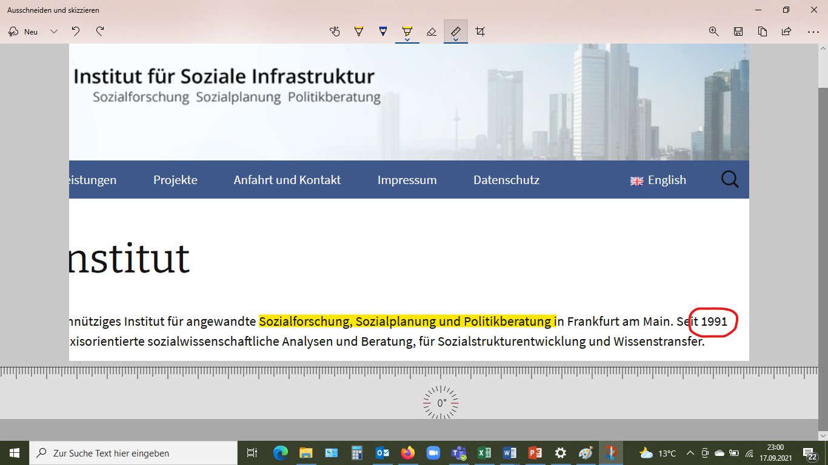
Exercise for the learning unit

Slide 14
Editing graphics with Paint.NET
“Paint.net is a freeware raster graphics editor program for Microsoft Windows, developed on the .NET Framework. Paint.net was originally created by Rick Brewster as a Washington State University student project, and has evolved from a simple replacement for the Microsoft Paint program into a program for editing mainly graphics, with support for plugins.”
(https://en.wikipedia.org/wiki/Paint.net)
Notes:
The software can be downloaded free of charge at getpaint.net, for example.

Slide 15
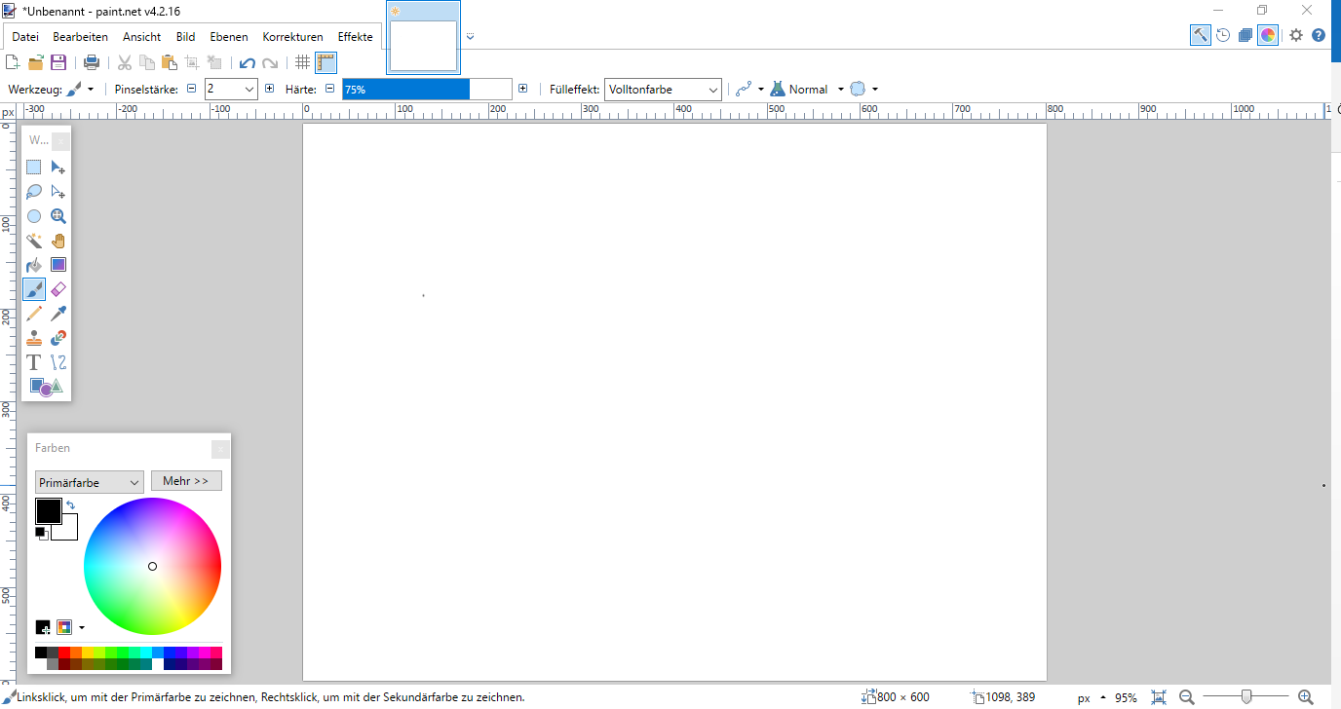
Notes:
A useful function in Paint.net is to remove the background of logos and other graphics.

Slide 16
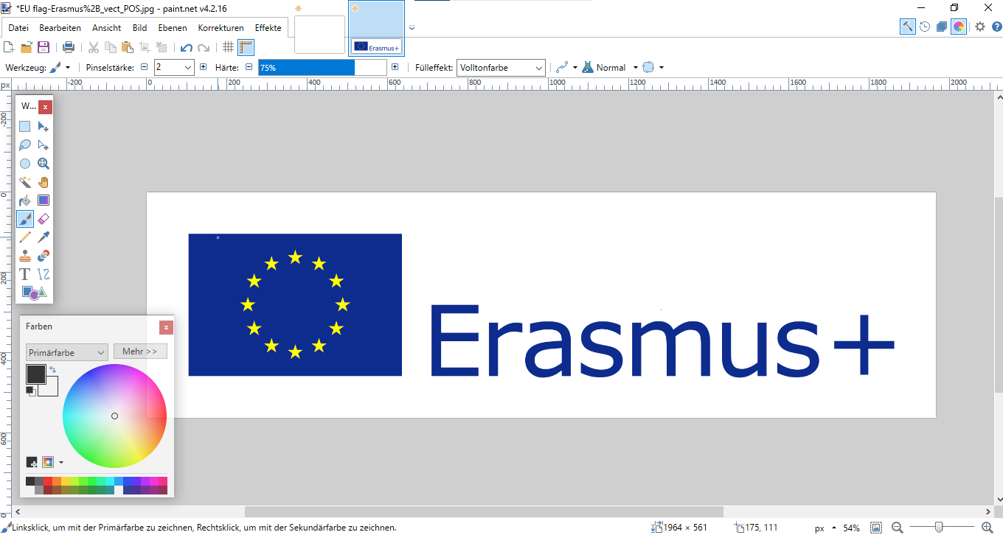
Notes:
To do this, first open (or paste) the logo you want to remove the background from.

Slide 17
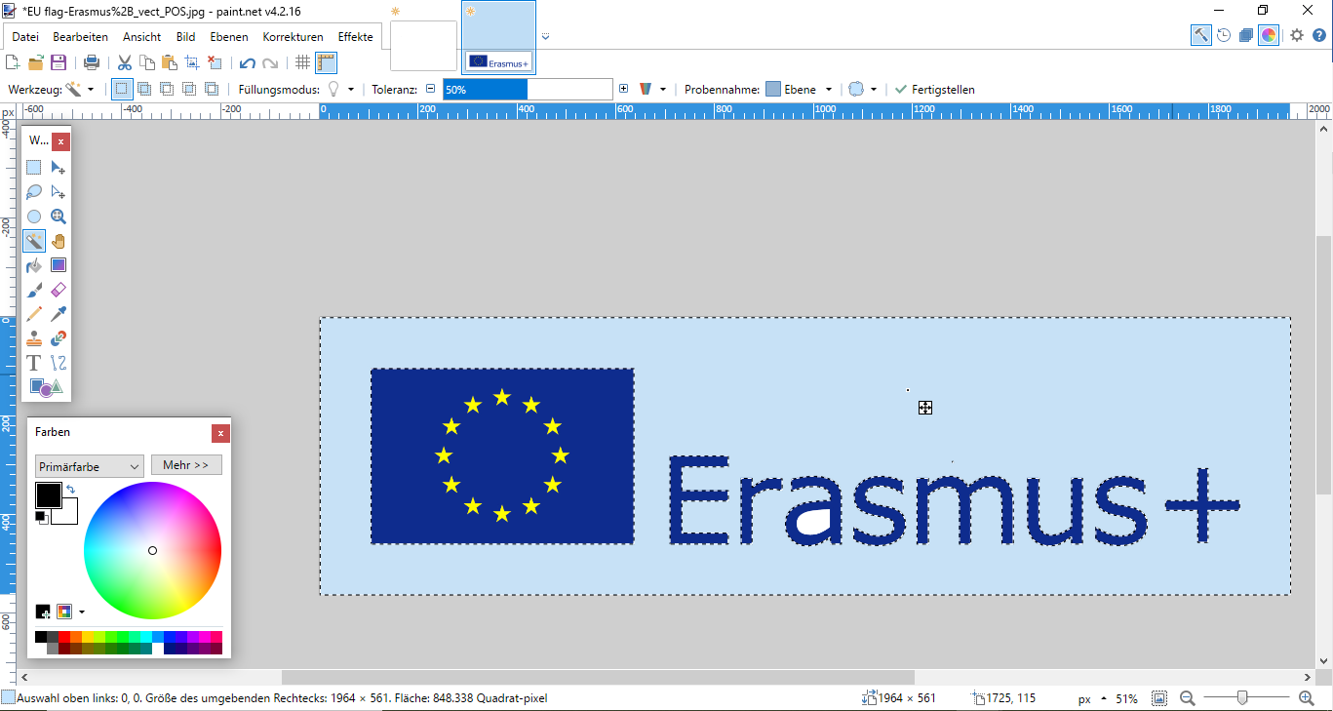
Press "ctrl" and select all inner fields.
Notes:
After opening the image, select the „magic wand" tool.

Slide 18
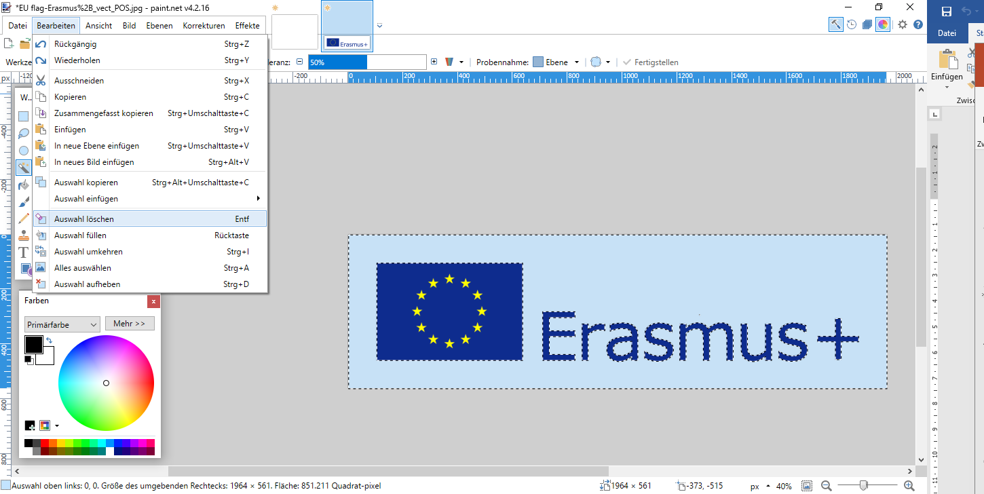

Slide 19
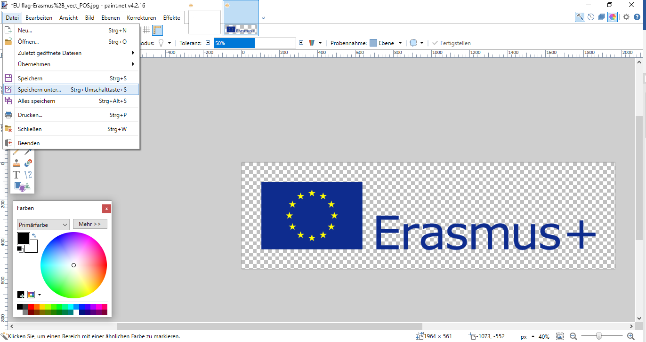
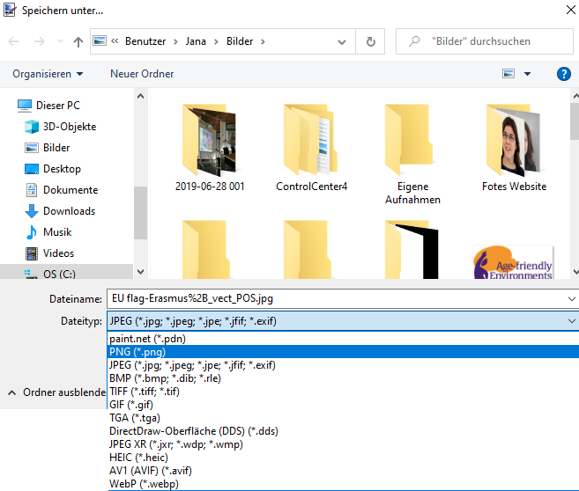

Slide 20
Excercise:
If feasible, 2 persons work as a tandem with one laptop. Open MS Publisher if available (or alternatively work with PowerPoint).
Create a poster in Din A1 (59.4 cm x 84.1 cm, set in PowerPoint under: Design slide size)
Insert a text box, a graphic and/or an image (e.g. from an image database).
Try out different functions as well as the „Snip and Sketch" app.

Slide 21






About this presentation
This presentation is part of the digital training developed within the Bridge the Gap! project. Project website: www.bridgethegap-project.eu
Copyright (c) 2022 Jana Eckert, ISIS Institute for Social Infrastructure gGmbH
This publication is licensed under a Creative Commons Attribution-ShareAlike 4.0 International Licence (CC BYSA 4.0).
This project has been funded with support from the European Commission. This publication reflects the views only of the authors, and the Commission cannot be held responsible for any use which may be made of the information contained therein.

